Slide 1

Introduction to the Rapid Barcoding Kit
TB ONT workshop – NIMR August 2022
Dr Linzy Elton
Postdoctoral research associate
Centre for Clinical Microbiology
linzy.elton@ucl.ac.uk
@LinzyElton @PandoraIDNet @AmrCovid

Slide 2
TB ONT workshop – NIMR August 2022
We will record these sessions and put them online so you can refer back to them later on
We will also put the slides up online so you can access the notes (links and image credits)

Slide 3
TB ONT workshop – NIMR August 2022
Why the Rapid Barcoding Kit (SQK-RBK004)?
Quick and user friendly
Can multiplex up to 12 whole genome samples per flow cell run
Relatively good output (for long reads to be observed in sequencing, long fragments need to be present in the sample in the first place)
Better coverage compared to PCR based kits (and therefore removes PCR bias – see link in notes)
Cheaper than other kits (e.g. ligation kit) as no other third party reagents are needed
Notes:
What is PCR bias: https://www.ncbi.nlm.nih.gov/pmc/articles/PMC1317340/#:~:text=PCR%20bias%20is%20thought%20to,stages%20of%20amplification%20(31).

Slide 4
TB ONT workshop – NIMR August 2022
Rapid Barcoding Kit – basic steps
QC flow cell
Add barcodes to each sample
Attach rapid sequencing adaptor protein
Prepare flow cell for sequencing
Prepare DNA library
Set up a sequencing run (MinKNOW software)

Slide 5
TB ONT workshop – NIMR August 2022
Equipment and consumables needed for Rapid Barcoding Kit
Microfuge
Vortex mixer
Thermal cycler at 30°C and 80°C
P1000 pipette and tips
P100 pipette and tips
P20 pipette and tips
P10 pipette and tips
P2 pipette and tips
Timer
Nuclease free water
PCR tubes
1.5 mL Lo-bind tubes

Slide 6
TB ONT workshop – NIMR August 2022
DNA input
400 ng and MW of >30kb*
Input volume is 7.5 µL, which works out to be ~53 ng/µL
If your samples have very different MWs, try normalising for fmol instead to get more even numbers of reads per barcode (see notes below for online calculator)
* For tuberculosis = may want lower MW (trade off between long reads and pore efficiency, see presentation #2)
Notes:
https://nebiocalculator.neb.com/#!/dsdnaamt

Slide 7
TB ONT workshop – NIMR August 2022
1. QC the flow cell
Quality Control (QC) of flow cells should be done within a few days of them arriving in your laboratory (if they are below the warranty of 800 pores, you can request replacements)
You will also need to QC the flow cells again just before you run an experiment
This will identify how many active pores you have on your flow cell (the more pores that are active, the more data you should obtain)

Slide 8
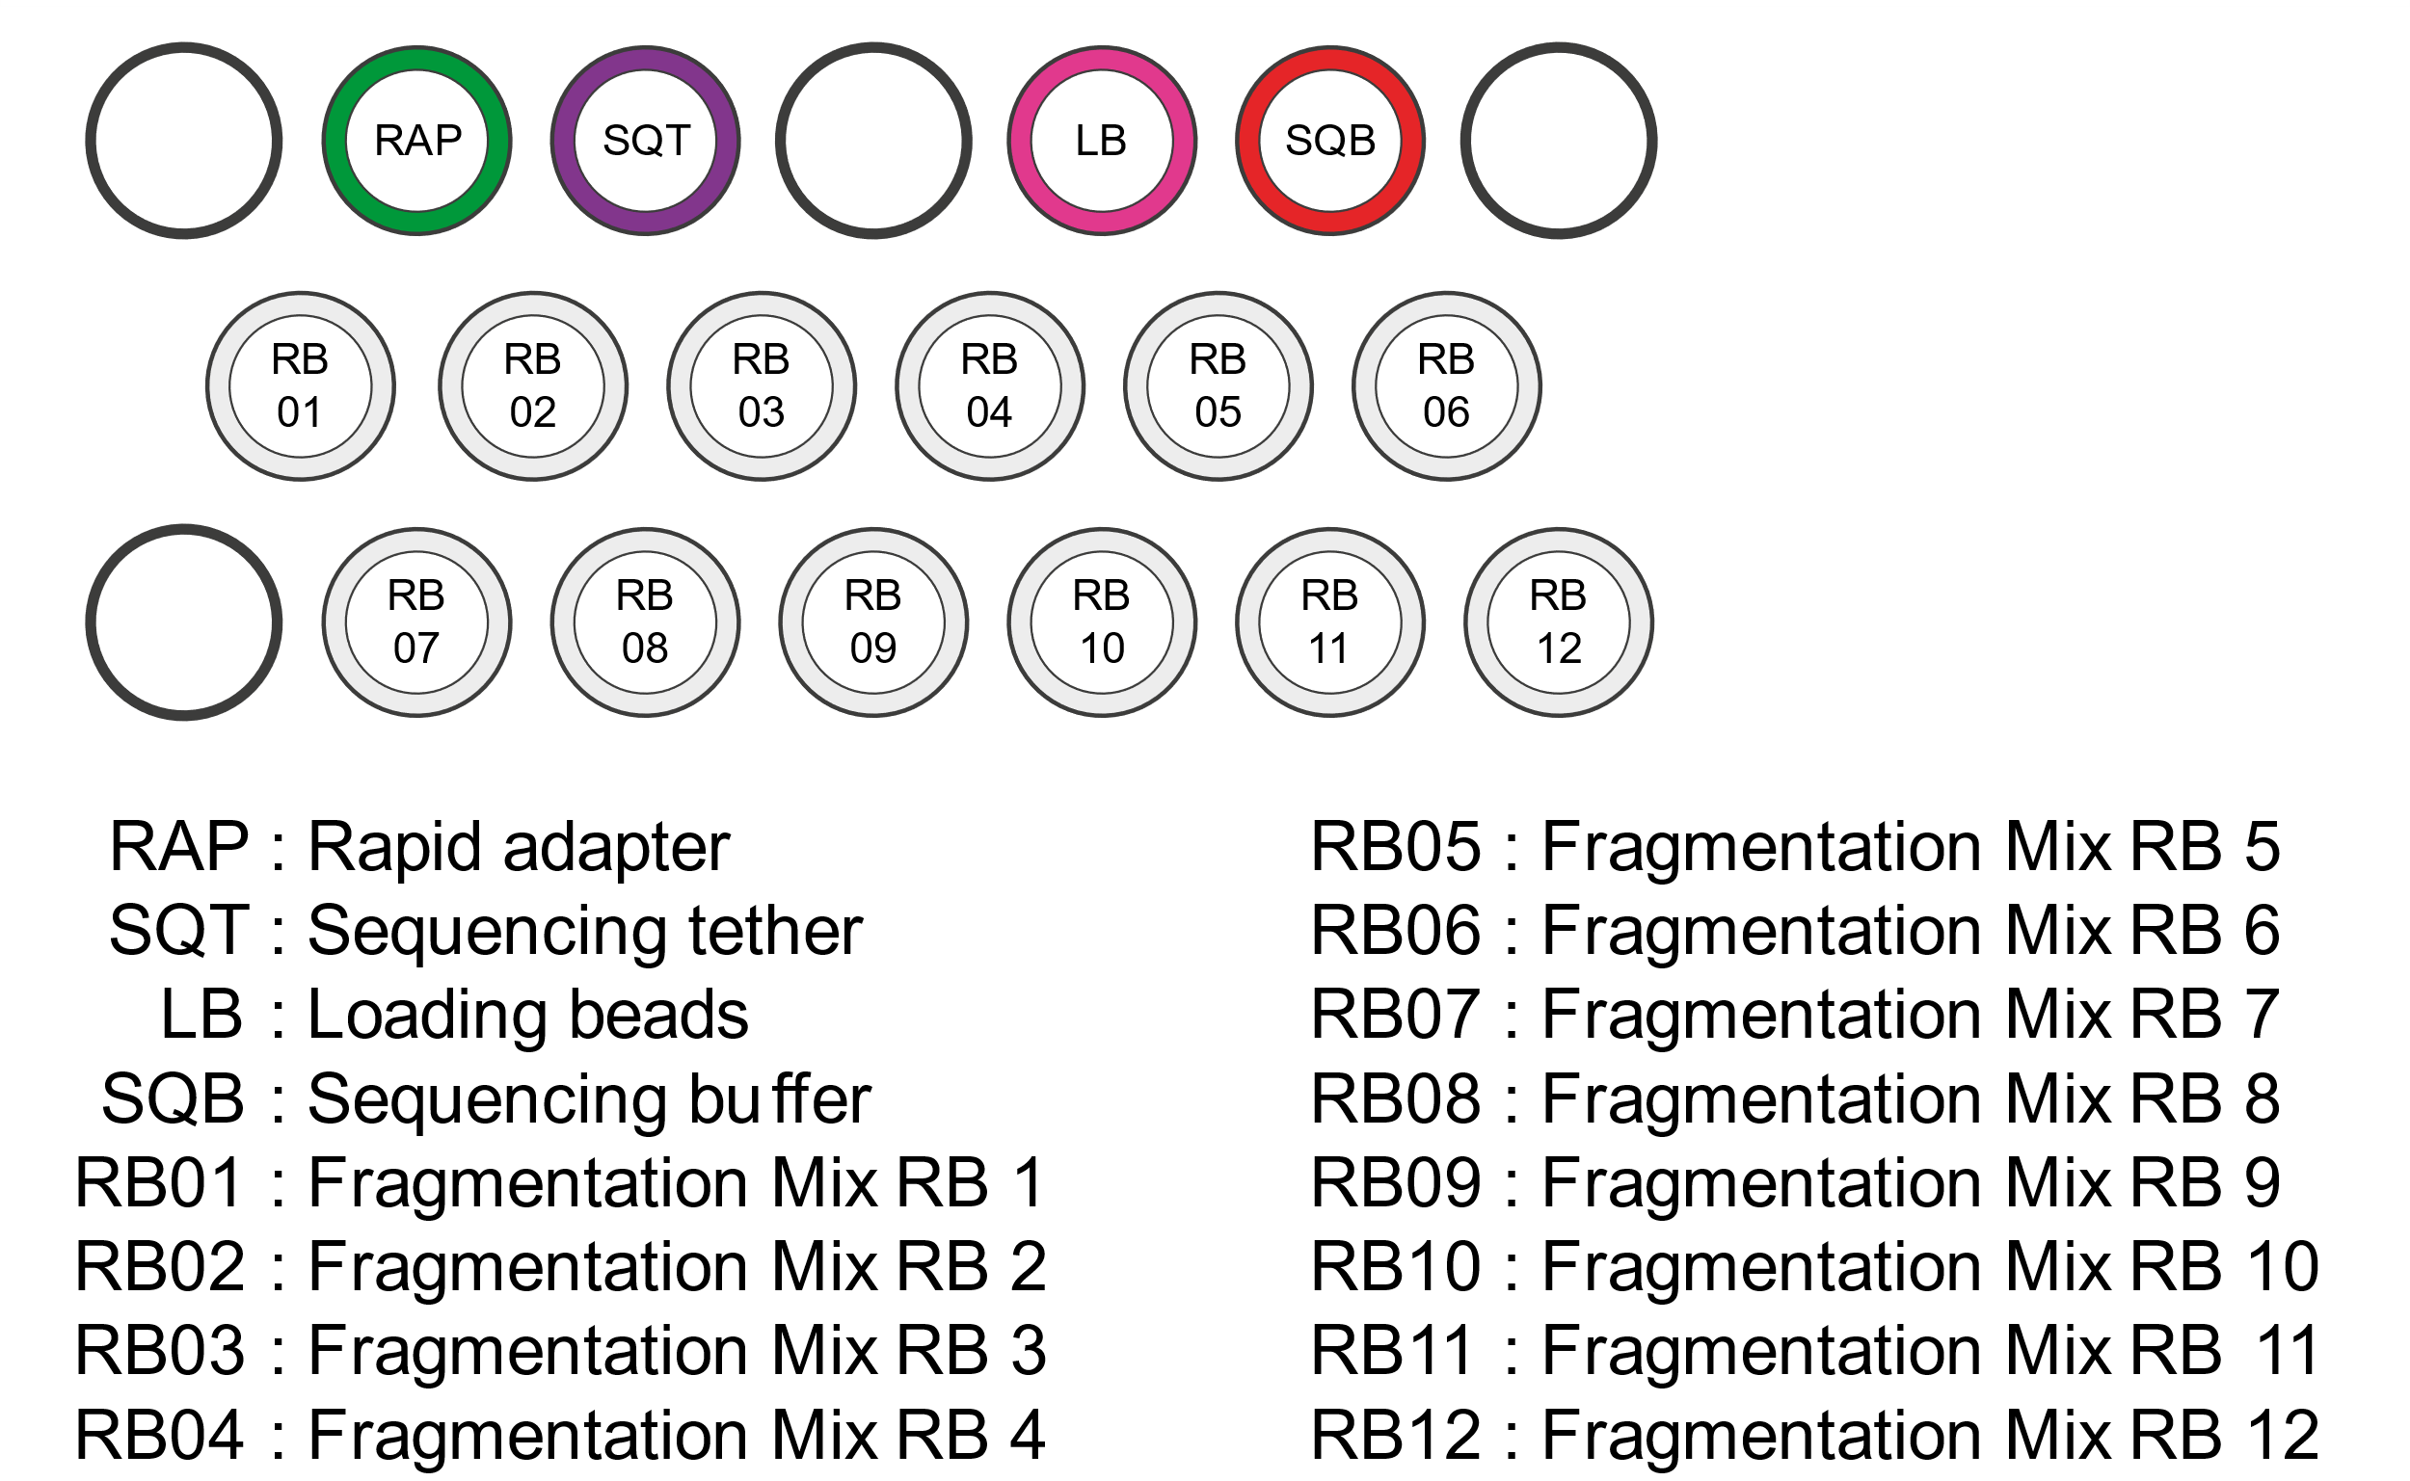
TB ONT workshop – NIMR August 2022
Rapid barcoding kit: What’s in the box?
Notes:
Rapid barcoding kit Nanopore website: https://store.nanoporetech.com/uk/rapid-barcoding-kit.html

Slide 9
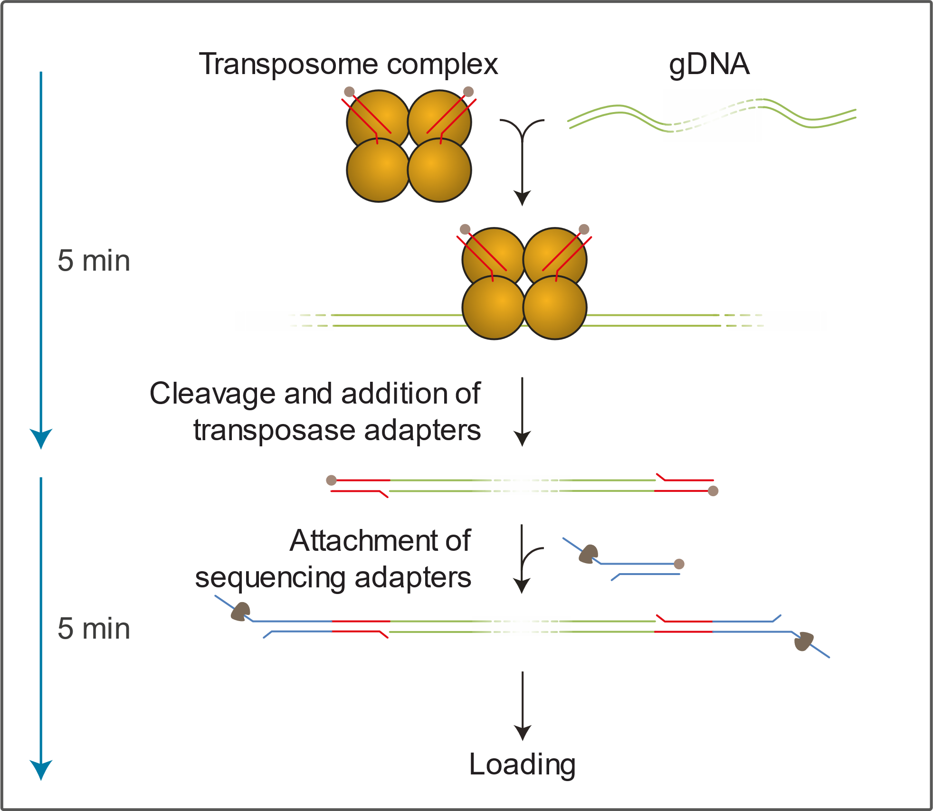
TB ONT workshop – NIMR August 2022
2. Addition of barcodes to samples
Transposon-based fragmentation: transposase simultaneously cleaves template molecules and attaches barcoded tags to the cleaved ends
There are 12 unique barcoded tags in the kit
Barcodes are attached to the DNA by heating
Once the barcodes are attached, samples can be pooled
Samples are identified (demultimplexed) by computer programmes such as Guppy)
Notes:
Image credit: https://store.nanoporetech.com/rapid-sequencing-kit.html

Slide 10
TB ONT workshop – NIMR August 2022
3. Rapid adaptor protein addition
Once the samples are pooled, the Rapid Adaptor Protein (RAP) is added (incubation for 5 minutes at room temperature)
RAP helps to guide the DNA to the pores

Slide 11

TB ONT workshop – NIMR August 2022
Flow cell priming kit: what’s in the box?

Slide 12
TB ONT workshop – NIMR August 2022
4. Preparation of the flow cell
Prepare flow cell – changing storage buffer to sequencing flush buffer
Flow cells are supplied with storage buffer (yellow in colour) covering the active pores
The storage buffer must be replaced by sequencing flush buffer (clear in colour) to enable the correct conditions for sequencing
Sequencing flush buffer is made up from Flush buffer (FB) (~1.5 mL) and Flush tether (FT) (30 µL) (both come in the Flow Cell Priming Kit)
The Flow Cell Priming Kit comes with each sequencing preparation kit
It is VERY IMPORTANT that you do not introduce air bubbles into the flow cell when you add the sequencing flush buffer (if air touches an pore, it will become inactive)

Slide 13
TB ONT workshop – NIMR August 2022
Flush Buffer: where does it go?
Notes:
Image credit: https://currentprotocols.onlinelibrary.wiley.com/doi/abs/10.1002/cphg.39

Slide 14
TB ONT workshop – NIMR August 2022
5. Preparation of DNA library
The barcoded DNA (with attached RAP) is then mixed with sequencing buffer (SQB), loading beads (LB) and nuclease free water
This mixture is loaded into the SpotON port on the flow cell (approx. 75 µL)

Slide 15
TB ONT workshop – NIMR August 2022
Sample loading: where does it go?
Notes:
Image credit: https://currentprotocols.onlinelibrary.wiley.com/doi/abs/10.1002/cphg.39

Slide 16
TB ONT workshop – NIMR August 2022
6. Setting up a sequencing run
Once the flow cell has been prepared and the sample loaded, the ports are closed and MinKNOW used to set up a sequencing run

Slide 17
TB ONT workshop – NIMR August 2022
6. Setting up a sequencing run

Slide 18
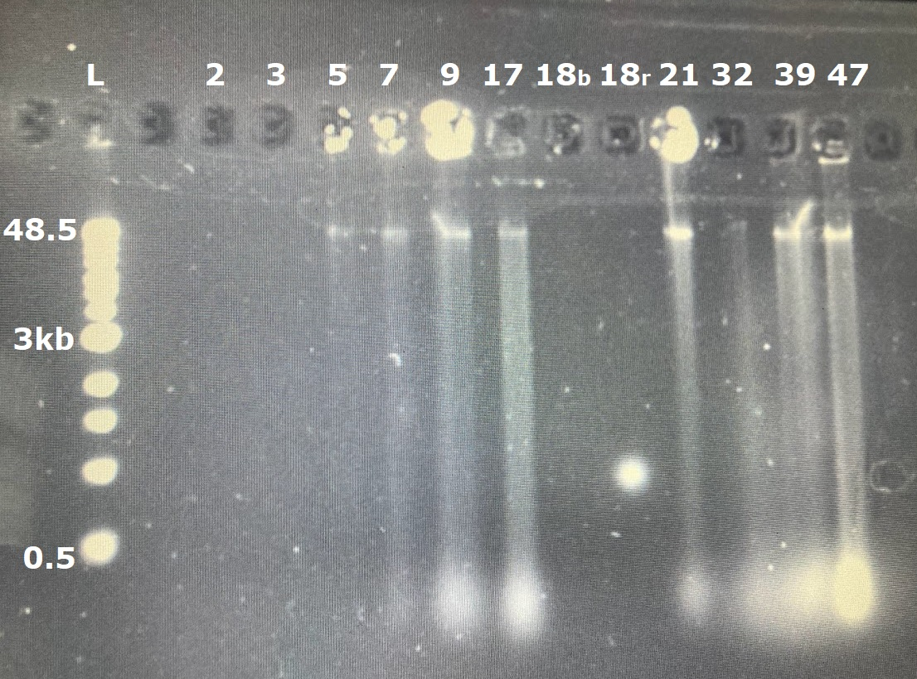
TB ONT workshop – NIMR August 2022
Extraction results
High molecular weight (could do clean up to remove small fragments at the bottom)

Slide 19
TB ONT workshop – NIMR August 2022
Extraction results
Sample | Nanodrop | A260/280 | A260/230 | Qubit
2 | 1.5 ng/µL | 2.25 | 0.39 | Too low
3 | 5.3 ng/µL | 1.30 | 0.30 | Too low
5 | 6.2 ng/µL | 2.47 | 0.51 | 13.5 ng/µL
7 | 20.5 ng/µL | 1.77 | 0.86 | 29.4 ng/µL
9 | 83.5 ng/µL | 1.71 | 0.92 | 502 ng/µL
17 | 65.5 ng/µL | 1.76 | 0.74 | 364 ng/µL
18 B | 5.1 ng/µL | 2.04 | 0.23 | 3.10 ng/µL
18 R | 2.6 ng/µL | 3.57 | 0.29 | Too low
21 | 114.4 ng/µL | 1.91 | 1.46 | 190 ng/µL
32 | 3.4 ng/µL | 3.08 | 0.32 | Too low
39 | 71.8 ng/µL | 1.97 | 1.22 | 1,200 ng/µL
47 | 49.7 ng/µL | 1.91 | 1.04 | 96.4 ng/µL

Slide 20
TB ONT workshop – NIMR August 2022
Extraction results
Sample | Nanodrop | A260/280 | A260/230 | Qubit
2 | 1.5 ng/µL | 2.25 | 0.39 | Too low
3 | 5.3 ng/µL | 1.30 | 0.30 | Too low
5 | 6.2 ng/µL | 2.47 | 0.51 | 13.5 ng/µL
7 | 20.5 ng/µL | 1.77 | 0.86 | 29.4 ng/µL
9 | 83.5 ng/µL | 1.71 | 0.92 | 502 ng/µL
17 | 65.5 ng/µL | 1.76 | 0.74 | 364 ng/µL
18 B | 5.1 ng/µL | 2.04 | 0.23 | 3.10 ng/µL
18 R | 2.6 ng/µL | 3.57 | 0.29 | Too low
21 | 114.4 ng/µL | 1.91 | 1.46 | 190 ng/µL
32 | 3.4 ng/µL | 3.08 | 0.32 | Too low
39 | 71.8 ng/µL | 1.97 | 1.22 | 1,200 ng/µL
47 | 49.7 ng/µL | 1.91 | 1.04 | 96.4 ng/µL

Slide 21
TB ONT workshop – NIMR August 2022
Extraction results
Sample | Nanodrop | A260/280 | A260/230 | Qubit
2 | 1.5 ng/µL | 2.25 | 0.39 | Too low
3 | 5.3 ng/µL | 1.30 | 0.30 | Too low
5 | 6.2 ng/µL | 2.47 | 0.51 | 13.5 ng/µL
7 | 20.5 ng/µL | 1.77 | 0.86 | 29.4 ng/µL
9 | 83.5 ng/µL | 1.71 | 0.92 | 502 ng/µL
17 | 65.5 ng/µL | 1.76 | 0.74 | 364 ng/µL
18 B | 5.1 ng/µL | 2.04 | 0.23 | 3.10 ng/µL
18 R | 2.6 ng/µL | 3.57 | 0.29 | Too low
21 | 114.4 ng/µL | 1.91 | 1.46 | 190 ng/µL
32 | 3.4 ng/µL | 3.08 | 0.32 | Too low
39 | 71.8 ng/µL | 1.97 | 1.22 | 1,200 ng/µL
47 | 49.7 ng/µL | 1.91 | 1.04 | 96.4 ng/µL

Slide 22
TB ONT workshop – NIMR August 2022
Extraction results
Good A260/280 ~1.8
Sample | Nanodrop | A260/280 | A260/230 | Qubit
2 | 1.5 ng/µL | 2.25 | 0.39 | Too low
3 | 5.3 ng/µL | 1.30 | 0.30 | Too low
5 | 6.2 ng/µL | 2.47 | 0.51 | 13.5 ng/µL
7 | 20.5 ng/µL | 1.77 | 0.86 | 29.4 ng/µL
9 | 83.5 ng/µL | 1.71 | 0.92 | 502 ng/µL
17 | 65.5 ng/µL | 1.76 | 0.74 | 364 ng/µL
18 B | 5.1 ng/µL | 2.04 | 0.23 | 3.10 ng/µL
18 R | 2.6 ng/µL | 3.57 | 0.29 | Too low
21 | 114.4 ng/µL | 1.91 | 1.46 | 190 ng/µL
32 | 3.4 ng/µL | 3.08 | 0.32 | Too low
39 | 71.8 ng/µL | 1.97 | 1.22 | 1,200 ng/µL
47 | 49.7 ng/µL | 1.91 | 1.04 | 96.4 ng/µL

Slide 23
TB ONT workshop – NIMR August 2022
Extraction results
Good A260/280:
~1.8
Good A260/230:
2.0-2.2
Sample | Nanodrop | A260/280 | A260/230 | Qubit
2 | 1.5 ng/µL | 2.25 | 0.39 | Too low
3 | 5.3 ng/µL | 1.30 | 0.30 | Too low
5 | 6.2 ng/µL | 2.47 | 0.51 | 13.5 ng/µL
7 | 20.5 ng/µL | 1.77 | 0.86 | 29.4 ng/µL
9 | 83.5 ng/µL | 1.71 | 0.92 | 502 ng/µL
17 | 65.5 ng/µL | 1.76 | 0.74 | 364 ng/µL
18 B | 5.1 ng/µL | 2.04 | 0.23 | 3.10 ng/µL
18 R | 2.6 ng/µL | 3.57 | 0.29 | Too low
21 | 114.4 ng/µL | 1.91 | 1.46 | 190 ng/µL
32 | 3.4 ng/µL | 3.08 | 0.32 | Too low
39 | 71.8 ng/µL | 1.97 | 1.22 | 1,200 ng/µL
47 | 49.7 ng/µL | 1.91 | 1.04 | 96.4 ng/µL

Slide 24
TB ONT workshop – NIMR August 2022
Extraction results
These samples are good enough to sequence
Sample | Nanodrop | A260/280 | A260/230 | Qubit
2 | 1.5 ng/µL | 2.25 | 0.39 | Too low
3 | 5.3 ng/µL | 1.30 | 0.30 | Too low
5 | 6.2 ng/µL | 2.47 | 0.51 | 13.5 ng/µL
7 | 20.5 ng/µL | 1.77 | 0.86 | 29.4 ng/µL
9 | 83.5 ng/µL | 1.71 | 0.92 | 502 ng/µL
17 | 65.5 ng/µL | 1.76 | 0.74 | 364 ng/µL
18 B | 5.1 ng/µL | 2.04 | 0.23 | 3.10 ng/µL
18 R | 2.6 ng/µL | 3.57 | 0.29 | Too low
21 | 114.4 ng/µL | 1.91 | 1.46 | 190 ng/µL
32 | 3.4 ng/µL | 3.08 | 0.32 | Too low
39 | 71.8 ng/µL | 1.97 | 1.22 | 1,200 ng/µL
47 | 49.7 ng/µL | 1.91 | 1.04 | 96.4 ng/µL

Slide 25
TB ONT workshop – NIMR August 2022
Sequencing
Sample | ng/µL | MW
9 | 83.5 | 48,500
17 | 65.5 | 48,500
21 | 190 | 48,500
39 | 71.8 | 48,500
47 | 96.4 | 48,500
TBA4 | 197 | 49,655
TBA2 | 240 | 36,783
Notes:
TBA4 is a M. tuberculosis isolate extracted as a control

Slide 26
TB ONT workshop – NIMR August 2022
Task:
You know that you need 400 ng of DNA in 7.5 µL
400 ÷ 7.5 = 53.3 ng/µL
You now need to work out how many µL of each sample to input to ensure you have 400 ng of each
And work out how much water you need to add to make up 7.5 µL

Slide 27
TB ONT workshop – NIMR August 2022
Concentration calculator (C1V1=C2V2)
C1 = starting concentration
V1 = starting volume
C2 = final concentration
V2 = final volume

Slide 28
TB ONT workshop – NIMR August 2022
Concentration calculator (C1V1=C2V2)
C1 = starting concentration
V1 = starting volume
C2 = final concentration
V2 = final volume

Slide 29
TB ONT workshop – NIMR August 2022
Concentration calculator (C1V1=C2V2)
C1 = Different for each sample
V1 = ?
C2 = 53.3 ng/ul
V2 = 7.5 ul

Slide 30
TB ONT workshop – NIMR August 2022
Concentration calculator (C1V1=C2V2)
V1 = V2 * C2 / C1

Slide 31
TB ONT workshop – NIMR August 2022
Sequencing
C2 = 53.3
V2 = 7.5
V1 = V2 * C2 / C1
Don’t forget to calculate the water!
Sample | ng/µL
9 | 83.5
17 | 65.5
21 | 190
39 | 71.8
47 | 96.4
TBA4 | 197
TBA2 | 240

Slide 32
TB ONT workshop – NIMR August 2022
Amount of sample DNA needed:
Sample | DNA | NFW
9 | 4.8 | 2.7
17 | 6.1 | 1.4
21 | 2.1 | 5.4
39 | 5.6 | 1.9
47 | 4.1 | 3.4
TBA4 | 2.0 | 5.5
TBA2 | 1.7 | 5.8

